Slide 1

Word Recognition
Tips & Tricks
AEAUT Conference, October 2021
Shauna K. Brown

Slide 2

What is literacy?
Notes:
How many adults in Utah County are functionally illiterate?
Over 28,000!
What percent of the workforce (nationally) is functionally illiterate?
15%
Source: ?

Slide 3
Literacy Quiz
How many adults in Utah are functionally illiterate?
What percent of the workforce (nationally) is functionally illiterate?
Notes:
How many adults in Utah are considered functionally illiterate?
Over 287,320! (PIAAC)
What percent of the workforce (nationally) is functionally illiterate?
15% and 85% of the unemployed struggle with literacy skills (NIFL)

Slide 4
Literacy Quiz
What percent of Americans cannot determine correct change?
What percent of Americans cannot address an envelope well enough to reach its destination?
Notes:
What percent of Americans cannot determine correct change?
40% (APL)
What percent of Americans cannot address an envelope well enough to reach its destination?
25%
Source: ?

Slide 5
Literacy – Below Basic Skills
Can usually Perform | Cannot Usually Perform
Sign one’s name | Locate eligibility from a table of employee benefits
Identify a country in a short article | Locate intersection on a street map
Locate one piece of information in a sports article | Locate two pieces of information in a sports article
Locate the expiration date information on a driver’s license | Identify and enter background information on a social security card application
Total a bank deposit entry | Calculate total costs of purchase from an order form

Slide 6

Visualization Activity
Notes:
Explain that adults learn in different ways. You’d like participants to look at how some of those differences will affect their decisions about tutoring.
Explain that you are going to lead the group through a guided visualization exercise to help them look at these differences. Ask them to assume they have completed part of the workshop. They have been assigned some reading for homework. It is now the weekend and time to do the assignment. Ask participants to close their eyes and keep them closed. Then read aloud slowly, in a very calm and relaxed voice, the “Visualization Activity.”
Ask participants to open their eyes. Ask for two volunteers to share where and when they decided to do their reading and what else they wanted to have with them.
Do a survey of the group.
Ask participants to explain how knowing about these differences can help them in their tutoring.
Explain that there are a lot of things that tutors won’t be able to change about the environment where they tutor. However, they can often adapt it to better fit the learner.
Ask participants to share how the workshop environment does or doesn’t work for them. What would they change to make it a more effective learning place for them?

Slide 7
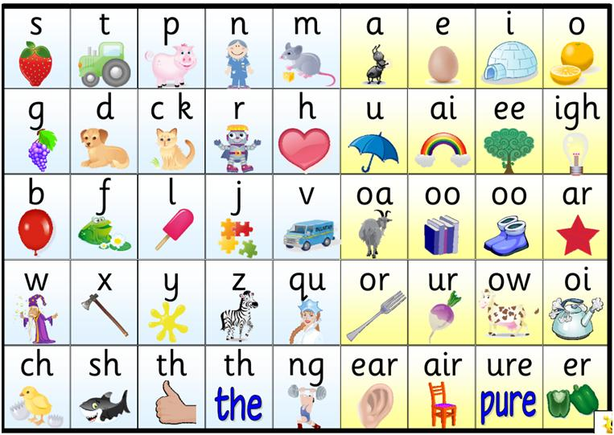
I take it you already know …
Notes:
I take it you already know
Of tough and bough and cough and dough?
Others may stumble but not you
On hiccough, thorough, slough and through.
Well done! And now you wish perhaps,
To learn of less familiar traps?
Beware of heard, a dreadful word
That looks like beard and sounds like bird.
And dead, it's said like bed, not bead-
for goodness' sake don't call it 'deed'!
Watch out for meat and great and threat
(they rhyme with suite and straight and debt).
A moth is not a moth in mother,
Nor both in bother, broth, or brother,
And here is not a match for there,
Nor dear and fear for bear and pear,
And then there's doze and rose and lose-
Just look them up- and goose and choose,
And cork and work and card and ward
And font and front and word and sword,
And do and go and thwart and cart-
Come, I've hardly made a start!
A dreadful language? Man alive!
I'd learned to speak it when I was five!
And yet to write it, the more I sigh,
I'll not learn how 'til the day I die.

Slide 8
Signs
What are some signs your student needs help with word recognition?
Guessing at words rather than decoding with automaticity and fluency.
Memorizing printed text after hearing it read aloud many times and then pretending to read.
Attempting to memorize every word with frequent seeming lapses in memory.
Reading (both silently and orally) in a slow, labored style that interferes with comprehension.
Notes:
Signs:
Attempting to memorize every word with frequent seeming lapses in memory
Reading (both silently and orally) in a slow and labored style which interferes with comprehension
Students whose reading instruction has occurred in a classroom where the "whole language" philosophy has been used will demonstrate many or all of the above problems consistent with the lack of systematic, explicit instruction in phonemic awareness (the ability to hear and manipulate the sounds of the English language) and phonics (the ability to use the forty-plus sound-spelling correspondences) to independently decode (sound out words).
Bring sample of materials/resources available in the office—emphasize that there are a lot of materials available in the office, especially with grammar rules, etc. Although English has an exception to every rule, those exceptions follow their own rules, and they can be learned (e.g. i before e except after c, or when it says a as in neighbor and weigh).
Tell them that you are not going to cover word recognition “rules” in this presentation; however, you can refer them to Basic skills review (Appendix E p. 82) for advice on what to do when your student comes to a word s/he doesn’t know.

Slide 9
Alphabetics
Research has identified specific instructional practices that can be used to teach alphabetics
Phonemic Awareness: Effective strategies focus on teaching a few specific skills, especially blending and segmenting
Phonics: Effective strategies teach letter-sound correspondences in a systematic, direct, and explicit manner.
Notes:
Explain:
K–12 research suggests some specific strategies that may be used to teach alphabetics. These strategies focus on phonemic awareness and phonics.
Ask:
How many people have heard of phonemic awareness? How many use instructional strategies designed to help students increase their phonemic awareness? What strategies do you use?
How many are familiar with phonics and phonics instructional strategies? How many of you have used phonics instruction with your students?
Would anyone like to explain the relationship between phonemic awareness and phonics skills instruction?
[Answer: Phonemic awareness is related to but different from decoding or using phonics to make the connection between letters and the sounds they represent. Phonemic awareness is about speech sounds only. When we talk about phonics instruction we refer to training in the use of letter-sound relationships to identify words in reading or to approximate the spelling of words. Phonics instruction builds decoding skills, which depend to a large extent on phonemic awareness. One way to look at it is to say that you can do phonemic awareness activities in the dark because you only need to hear the sounds but you need to see the letters as well as hear the sounds for phonics activities.]
We’ll go into greater detail later today when we discuss instructional strategies to improve phonemic awareness and phonics skills but for now we’ll just note that:
For phonemic awareness, effective strategies focus on teaching a few specific skills, especially blending, or how to put individual phonemes or sounds together to form words, and segmenting, or how to break a word into its individual phonemes.
It’s interesting to note that contrary to how phonemic awareness training has traditionally been done, K-6 research suggests that teaching phonemic awareness with written letters is especially effective. Because this method includes having students make the connection between sounds and the letters that represent them this instructional technique would technically be phonics instruction.
Do:
Use a video clip with a student and instructor to demonstrate an instructor assessing and providing instruction on phonemic awareness. Ask participants to be on the lookout for blending and segmenting instruction.
Note: if a video can’t be shown, illustrate some phonemic awareness tasks for participants:
Putting individual phonemes together, or blending sounds. Example: C – A – T [say the sounds for each letter]. What word do these sounds make? [Answer: cat]
Deleting phonemes. Example: What is left if you remove the sound C [say the sound for the letter] from cat? [Answer: at]
Segmenting a word into individual phonemes. Example: How many sounds are there in the word “straw”? [4: s-t-r-aw]
Ask:
What questions do you have about what you just saw in the video or demonstration?
Explain:
For phonics, effective strategies teach letter-sound correspondences in a systematic, direct, and explicit manner.
Systematic instruction focuses on teaching students how to convert individual letters and letter combinations into their related sounds. Examples are the consonants, short vowels, and two-letter combinations that represent a single sound, such as the combination ‘oa’, pronounced ‘oh.’
Students are then taught to blend these individual sounds together to form a word. Systematic instruction may also they focus on converting larger letter combinations into their related sounds. Examples include common spelling patterns, such as ‘ing’, ‘able’, or ‘un’.
Teaching phonics also needs to be thorough. Scope and sequence charts for phonics instruction at the elementary level, for example, cover periods of up to three or four years.
There is one important caveat to keep in mind when working with adults with a learning disability. These beginning readers may have an especially difficult time with phonemic awareness tasks. The research seems to suggest that these adults, like children who are struggling with their reading, may need to be taught phonemic awareness with written materials, in the course of phonics instruction, as opposed to being taught exclusively with oral tasks.
For example, rather than being asked to imagine what the word ‘cat’ becomes when the first sound is removed, they are shown a written version of the word as they manipulate the sounds.
Do:
Use a video clip with a student and instructor to demonstrate an instructor assessing and providing instruction on phonics. Ask participants to be on the lookout for the sound-letter correspondence that’s critical in phonics assessment and instruction and for how this assessment and instruction differs from phonemic awareness assessment and instruction.
Note: if a video can’t be shown, illustrate some phonics instruction tasks for participants using the flipchart.
Use word pattern practice to illustrate that the combined vowels o+a make one sound pronounced “oh” and that this sound is found in many words with the word pattern oa.
Write the following letters on the fli[pchart and read the word patterns:
oa
oat
boat
coat
goat
ing
sing
ring
wing
King
Ask:
What questions do you have about what you just saw in the video or demonstration?

Slide 10
Phonemic Awareness
Phoneme Isolation: Recognizing individual sounds in words.
Phoneme Identity: Recognize the common sound in different words.
Phoneme Categorization: Recognize the word with the odd sound in a sequence of three to four words.
Phoneme Blending: Requires listening to a sequence of separately spoken words and combining them to form a recognizable word.
Phoneme Segmentation: Requires breaking a word into its sounds by tapping out or counting the sounds or by pronouncing and positioning a marker for each sound.
Notes:
Phoneme Isolation: Recognizing individual sounds in words (e.g. “Tell me the first sound in paste.”).
Phoneme Identity: Recognize the common sound in different words (e.g. “Tell me the sound that is the same in bike, boy, and bell.”).
Phoneme Categorization: Recognize the word with the odd sound in a sequence of three to four words (e.g. “Which word does not belong? bus, bun, rug”).
Phoneme Blending: Requires listening to a sequence of separately spoken words and combining them to form a recognizable word (e.g. “What word is /s/ /k/ /u/ /l/?”).
Phoneme Segmentation: Requires breaking a word into its sounds by tapping out or counting the sounds or by pronouncing and positioning a marker for each sound (e.g. “How many phonemes are there in ship?”).

Slide 11
Phonics Instruction
Synthetic Phonics: Learners are taught the letter-sound correspondences and then taught to blend the sounds to identify words. *Most commonly used*
Analytic Phonics: Learners do not pronounce the sounds in isolation; instead they analyze the sounds in a word that is already identified.
Phonics through Spelling: Learners break a word into its sounds and then identify the corresponding letters to spell the word.
Phonics in Context: Learners are taught to use both letter-sound correspondences and context clues to identify unfamiliar words.
Phonics by Analogy: Learners use parts of words they already know to identify unfamiliar words by analogy.
Notes:
Synthetic Phonics: Learners are taught the letter-sound correspondences and then taught to blend the sounds to identify words.
Analytic Phonics: Learners do not pronounce the sounds in isolation; instead they analyze the sounds in a word that is already identified.
Phonics through Spelling: Learners break a word into its sounds and then identify the corresponding letters to spell the word.
Phonics in Context: Learners are taught to use both letter-sound correspondences and context clues to identify unfamiliar words.
Phonics by Analogy: Learners use parts of words they already know to identify unfamiliar words by analogy. An example of phonics by analogy is learning how to use onsets (initial letter-sounds) and rimes like ack, op, and et (also called phonograms or word patterns) to sound out words.
Problem-solving strategies for decoding. Because decoding isn’t always enough, teach learners how to use other strategies in concert with phonics. For example, a beginning reader could learn this sequence for identifying an unknown word:
• Step 1: Try to sound it out from left to right. (Do you recognize the word? Does it make sense in the sentence? If yes, go on reading.)
• Step 2: If not, try a different vowel sound (long instead of short i for instance) or look for a rime or syllable you recognize (e.g., ack, ing or tion). Then put the parts
together and try again. (Do you recognize the word? Does it make sense in the sentence? If yes, go on reading.)
• Step 3: If not, read to the end of the sentence again and think of a word that makes sense. (Does this word match some of the letter sounds? If yes, go on reading, but
make a note to check on the word later.)
• Step 4: If not, ask someone for help.
Matching instruction to assessed needs
Not every learner needs a comprehensive introduction to phonics. Some adults may need only to brush-up on skills or fill in specific gaps in phonics knowledge, e.g., work on long vowel
sounds and diphthongs (au, aw, ou, ow, etc.). Still others may have little difficulty with short words, but don’t know how to approach multi-syllabic words. If you do initial assessment of (at least) all beginning readers, you will get an idea of what each individual needs to work on.
Practice is important. It takes immediate and plentiful practice to get decoding skills and knowledge into long-term memory and enable learners to apply what they’ve learned rapidly and
automatically.
One way to get practice is to read and reread words on lists and flash cards. Learners may read on their own or aloud with a partner, noting the words or sounds they
know and the ones they need to work on.
But they won’t often read words in isolation outside of the classroom, so even beginners need practice reading words in context. The most efficient way to do this is to
use controlled-vocabulary texts, which include many examples of words that exemplify the elements previously taught and no unfamiliar words that the learners can’t decode
with their current skills.

Slide 12

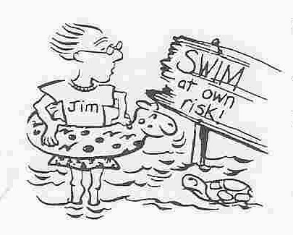

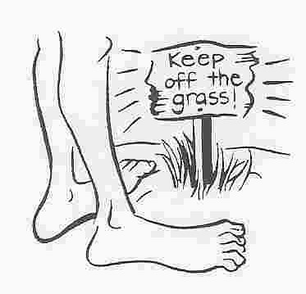
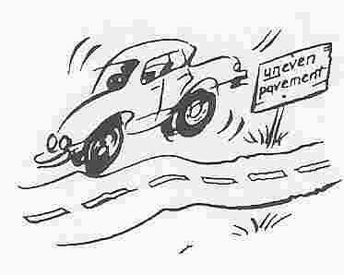
Strategies for Recognizing Words
Sight Words
Phonics
Word Patterns
Context
Word Parts
Notes:
Recognizing Words
To obtain meaning from text, a person must be able to understand the author’s message and react to it using prior information and experience. This can’t happen, however, if the reader is unable to recognize many of the words in the text.
Recognition is the ability to match words that people see in print with words they already use and know the meaning of. Good readers are able to draw on one of five word recognition strategies to do this.
Sight Words: Words that readers recognize instantly without having to stop to figure them out. The more proficient readers are, the more words they recognize by sight.
Phonics: The use of sound-symbol relationships to decode words.
Word Patterns: The use of familiar letter groupings to help recognize parts of words.
Context: The use of the surrounding words to help figure out an unfamiliar word.
Word parts: The use of root words, suffixes, prefixes, and other word parts to recognize words.
The strategies can be taught in any order. Start by building on what the learner already knows.
No one strategy works for all situations, and readers sometimes use multiple strategies to figure out a word. So the more strategies a person learns, the more likely that person is to recognize words successfully. These are some activities to help teach these strategies.

Slide 13
Sight Words
Survival Sight Word Flash Cards
Notes:
Sight Words: Survival Sight Words Flash Cards (p. 24)
Ask tutors what are some words they see every day in their lives and in common reading?
Work with your student to choose the words s/he wants to learn. For example:
Words from daily life,
Words from general writing, such as the, there, this, was, etc.
Words with irregular spellings that are difficult to sound out phonetically such as height.
Family names or words that appear on forms and applications

Slide 14
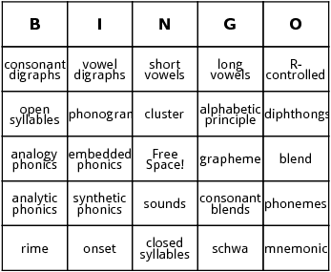
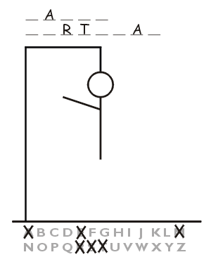
Phonics
BINGO
Disappearing Person
Notes:
Phonics: Bingo (p. 25)
Play phonics bingo with the group.
Select the consonant blends you want to work on.
Make bingo cards, one for your student and one for yourself (with the same blends so you can keep track)
Select words that start with each blend you wrote. Write these words on separate pieces of paper and put them face down in a pile.
Ask the student to pick a word from the pile, read it aloud, and then give the sound of the blend.
Each of you should then cover the matching blend on your own card with a square of blank paper.
The person who first covers five blends in a row wins and becomes the caller for the next game.
This can be adapted to ending consonant blends, digraphs, short vowels, r-controlled vowels, or another phonic element the student needs to practice.
Consonant Blend Bingo Words:
Brown
Snow
Friend
Squash
Small
Twirl
Drive
Switch
Blue
Flow
Fruit
Preach
Glisten
Street
Trend
Phonics: Disappearing person (p. 28)
Play disappearing person with group
Draw stick figure up on board.
Draw lines for each letter of a word
Ask your student to guess a letter
If the letter is in the word, write it on the correct line. If not, write the letter at the top of the board, and erase one of the body parts.
The student wins by guessing the word before you erase the last part of the stick figure.
Suggestions: choose words that contain sounds the student needs to practice. Also put lots of body parts on the stick figure.

Slide 15

Phonics

Slide 16
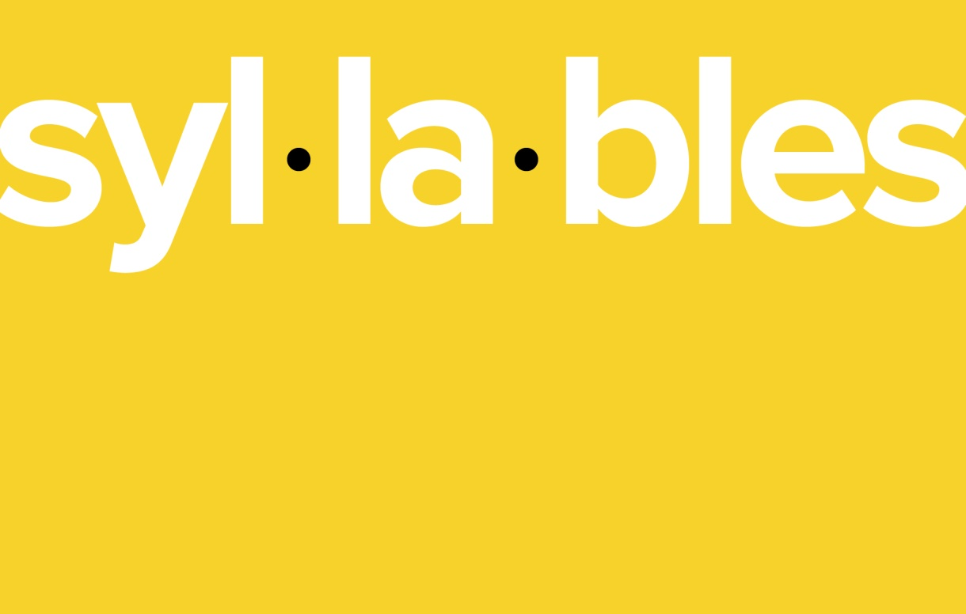
Phonics
Teaching Syllables
Three Rules for Syllables
  The two-consonant rule
  The one-consonant rule
  The one-consonant “oops” rule
Notes:
Teaching Syllables
Purpose: to enable learners to decode complex words by breaking the words into syllables.
Method:
Explain to the learner that a syllable is a word or part of a word that has only one vowel sound (not necessarily one vowel).
Give examples: bat (1), head (1), pa/per (2), lit/tle (2), em/ploy/ment (3).
Read words and ask how many vowel sounds the learner hears.
You can teach the three rules listed on the following page to a more advanced learner. (This is someone who is comfortable with the meaning of syllables and would benefit from more information about them.) Stop if the activity seems too difficult or frustrating for the learner.
Then give the learner a list of words.
Ask the learner to put a dot under each vowel.
Ask the learner to cross out any final e’s.
Ask the learner to underline digraphs and consonant blends.
Ask the learner to divide the words according to the three rules.
Suggestion: to help the learner hear the number of syllables, tap your finger on the table as you say each syllable. Later, the learner can do it independently.
Three rules for syllables
The two‑consonant rule:
If there are two consonants between the vowels, divide the word between the consonants.
in/to les/son traf/fic fen/der
· · · · · · · ·
Do not divide blends or digraphs.
bash/ful em/blem
· · · ·
The one‑consonant rule:
If the word has only one consonant sound between two vowels, divide the word before the consonant. If the vowel comes at the end of a syllable, it will usually have the long sound.
ba/con fe/male
· · · ·
The letter y in the middle or at the end of a word acts as a vowel.
la/dy sy/phon
· · · ·
The one‑consonant “oops” rule:
Sometimes the one-consonant rule does not work. When that happens, divide the word after the consonant. The vowel will have a short sound.
lem/on vis/it sec/ond ov/en trav/el
· · · · · · · · · ·

Slide 17
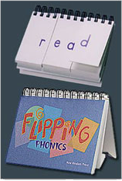
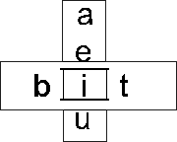
Word Patterns
Rhyming
Tachistoscopes/
Flipping Phonics
Notes:
Word Patterns: Rhyming (p. 30)
Make sure your student understands the concept of rhyming.
Choose a word pattern with which you can create several rhyming words (e.g. –it).
Write the word pattern at the top of a piece of paper; ask your student to say the sound; write a rhyming word under the pattern; ask the learner what the word is; write another rhyming word by changing the initial consonant; keep adding words and asking the student to read them; ask the student to add other words using the same pattern.
Example:
-it
sit
bit
fit
hit
lit
flit
Word Patterns: Tachistoscopes/Flipping phonics (p. 31-32)
Show flipping phonics/tachistoscopes.
Choose a word ending/pattern to work on.
Flip/slide through letters to make new words with ending/word pattern.
Ask student to read words. Nonsense words are allowed.

Slide 18
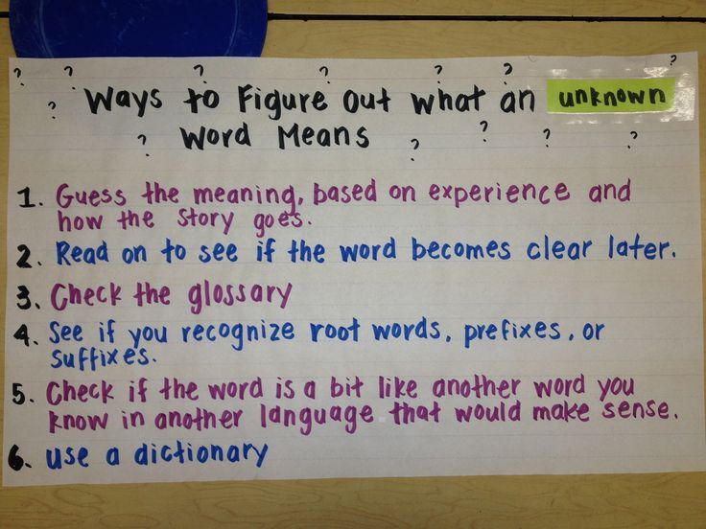
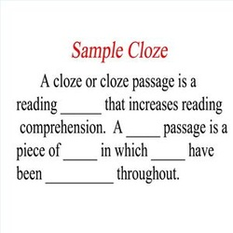
Context
Just say “blank”
CLOZE procedure
Notes:
Slide 61: Context: Just say “Blank” (p. 29)
When your student comes to a word they don’t know, tell them to just say “blank” (or another “code word”) and keep reading.
Encourage your student to use the rest of the sentence or paragraph to try to think of a word that would make sense in that “blank”
If there is more than one possibility, have them see if the first letter or sound helps narrow down the choices.
Then ask your student to read the sentence with the word they chose and see if it makes sense in context.
Context: CLOZE Procedure
Purpose: to help the learner practice using context—the meaning of surrounding words and sentences—to fill in missing words in a sentence or paragraph. (The word CLOZE comes from closure and means finishing or “closing” a sentence.)
Methods:
You can make a CLOZE exercise by selecting a passage that is at or below the learner’s current reading level. Leave the first sentence intact and then delete words in the subsequent sentences. Select words for which there are context clues. Example: “There were four eggs in the bird’s ,” not “There were eggs in the bird’s nest.”
Ask the learner to fill in the missing words.
Suggestion: remind the learner that it is most important to choose words that make sense in context. Unless the learner is working from a word list, it is not important to fill in the exact word.
Context: Using CLOZE with a Beginning Reader
Purpose: to provide additional support to help the beginning reader be successful with the CLOZE exercise described in Activity 12.
Suggestions:
Keep the passage short.
Delete very few words and no more than one per sentence.
If necessary, provide a word list for the learner to choose from.
Use material with which the learner is already familiar, such as a language experience story or a passage from a previous lesson.
If the material is new, give the learner an overview of the contents before he or she starts reading.
Provide the first letter for each word deleted.
Delete only one kind of word, such as nouns, in each passage. Tell the learner what kind of word you deleted.
Provide a choice of two words for each blank. You can also write the first letter of the word in the blank space so that the learner has both context and phonics clues.
Provide the exact number of spaces for the deleted word.
Ask the learner to say the missing word rather than writing it.
Ask the learner to explain why that word seems to be a good fit.

Slide 19
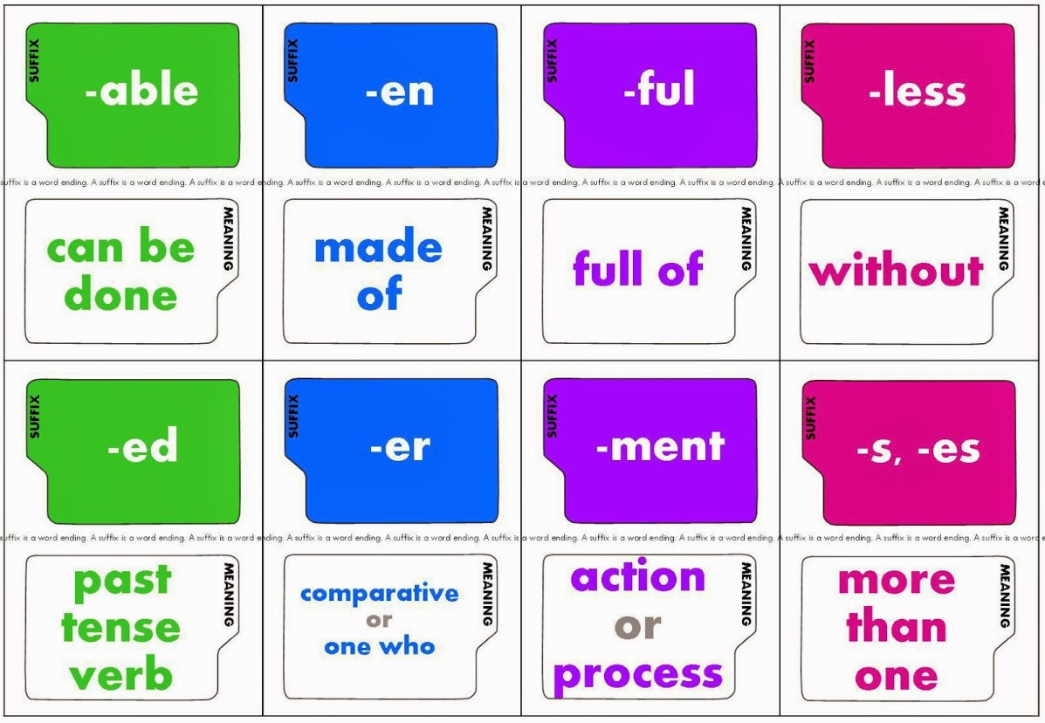
Word Parts
Compound Word Matching
Adding Endings to Words
Notes:
Slide 61: Word Parts: Compound Word Matching (p. 30)
Choose five or six compound words made up of smaller words your student already knows.
Put the first half of the word in one column, and the second half of the word in a second column.
Ask your student to connect the two words that form a compound word and then read the new word.
If you’re not sure that the learner recognizes the word, ask the learner to use it in a sentence.
Example:
Pay plane
Air room
Bed house
Grand check
Tree mother
Write words up on board and have them choose the matching ones.
Word Parts: Adding Endings to Words
Purpose: to help the learner select the correct rule when adding endings to words.
Methods:
Select the ending you will work on. Example: -ing.
Select the type of word to which you will add the ending. Example: verbs that end in e.
Explain to the learner the rule for adding the ending to this type of word. Example: When the word ends in e, drop the e before adding -ing.
Make two columns on a sheet of paper. In the first column, list four to six words that illustrate the rule you just taught.
Example:
give giving
live living
love
bake
shine
Ask the learner to read the first word and tell you what the word would be if the ending were added. Then write that word in the second column, or ask the learner to write it.
Ask the learner to do the rest of the words alone.
Finally, ask the learner to say a sentence using the words in each column.
Suggestions:
You can modify this activity to fit almost any word ending.
With a beginning reader, create a list where the learner applies the same rule to each word (as in the example above).
With a more advanced learner, you can mix the words. Ask the learner to decide which rule to use before adding the ending. Example: give, hit, kick. Ask the learner to say the word with the ending -ing and then apply the correct rule (simply add –ing; if the word ends in e, drop the e before adding –ing; or if a whort vowelword ends with only one consonant, double the final consonant before adding –ing) to write the new word (giving, hitting, kicking).

Slide 20
Questions?
Shauna K. Brown
Executive Director, Project Read
shauna@projectreadutah.org
Notes:
Slide 61: Word Parts: Compound Word Matching (p. 30)
Choose five or six compound words made up of smaller words your student already knows.
Put the first half of the word in one column, and the second half of the word in a second column.
Ask your student to connect the two words that form a compound word and then read the new word.
If you’re not sure that the learner recognizes the word, ask the learner to use it in a sentence.
Example:
Pay plane
Air room
Bed house
Grand check
Tree mother
Write words up on board and have them choose the matching ones.
Word Parts: Adding Endings to Words
Purpose: to help the learner select the correct rule when adding endings to words.
Methods:
Select the ending you will work on. Example: -ing.
Select the type of word to which you will add the ending. Example: verbs that end in e.
Explain to the learner the rule for adding the ending to this type of word. Example: When the word ends in e, drop the e before adding -ing.
Make two columns on a sheet of paper. In the first column, list four to six words that illustrate the rule you just taught.
Example:
give giving
live living
love
bake
shine
Ask the learner to read the first word and tell you what the word would be if the ending were added. Then write that word in the second column, or ask the learner to write it.
Ask the learner to do the rest of the words alone.
Finally, ask the learner to say a sentence using the words in each column.
Suggestions:
You can modify this activity to fit almost any word ending.
With a beginning reader, create a list where the learner applies the same rule to each word (as in the example above).
With a more advanced learner, you can mix the words. Ask the learner to decide which rule to use before adding the ending. Example: give, hit, kick. Ask the learner to say the word with the ending -ing and then apply the correct rule (simply add –ing; if the word ends in e, drop the e before adding –ing; or if a whort vowelword ends with only one consonant, double the final consonant before adding –ing) to write the new word (giving, hitting, kicking).

